Slide 1

ATTENDANCE
CHECKING
SYSTEM
PDM Mini Project Presentation

Slide 2
GROUP MEMBERS
Tran Duc Anh – ITITIU19079
Phan Nhat Tan – ITITIU19050
Nguyen Anh Tuan – ITITIU19061
Nguyen Phuoc Vinh Khang – ITITIU19017
Le Quang Huy – ITITIU19015

Slide 3
CONTENTS
01
Introduction
02
Database Diagram
03
Implementation
04
Conclusion
Introduce the system
Show and explain the database
Show the sql and java implementation
Summary the main idea and show the references

Slide 4

INTRODUCTION
1.1. OVERVIEW:
Data is essential information for every company.
A database is an organized collection of structured information, data, or typically stored electronically in a computer system.
Ours Group chose the topic: Attendance Management System.

Slide 5
INTRODUCTION
1.2. General Requirement:
1.2.1 Introduction:
The absence of lectures in college students has been a big concern.
Several student attendance systems have been devised to assist professors to maintain the attendance rate in class.
The administrators will get a table containing all the students and courses’ information at the beginning of the term.

Slide 6
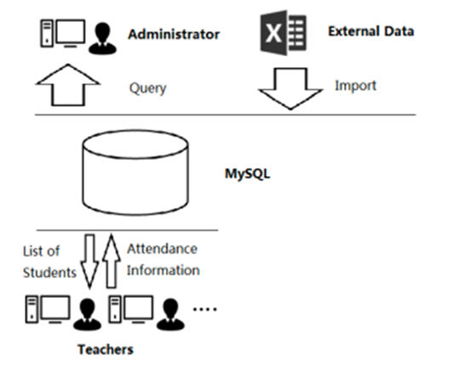
INTRODUCTION
fig 1. Attendance System’s process

Slide 7
INTRODUCTION
1.2. General Requirement
1.2.2. Project Proposal
Discuss about some realistic constraint.
Design the database following an E/R approach, double check for the normalization process.
Use MS SQL server to create the normalized tables.
Populate the database by using SQL server statements.
Using the JDBC library to connect the database with the java platform, then create the winform to demo the efficiencies of the database.

Slide 8

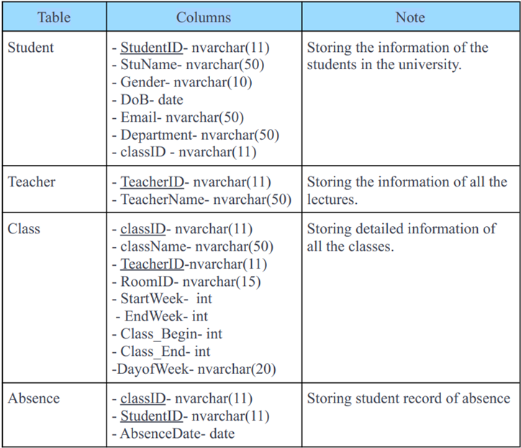
2. ERD AND RELATIONAL SCHEMA
2.1. Basic
Design

Slide 9

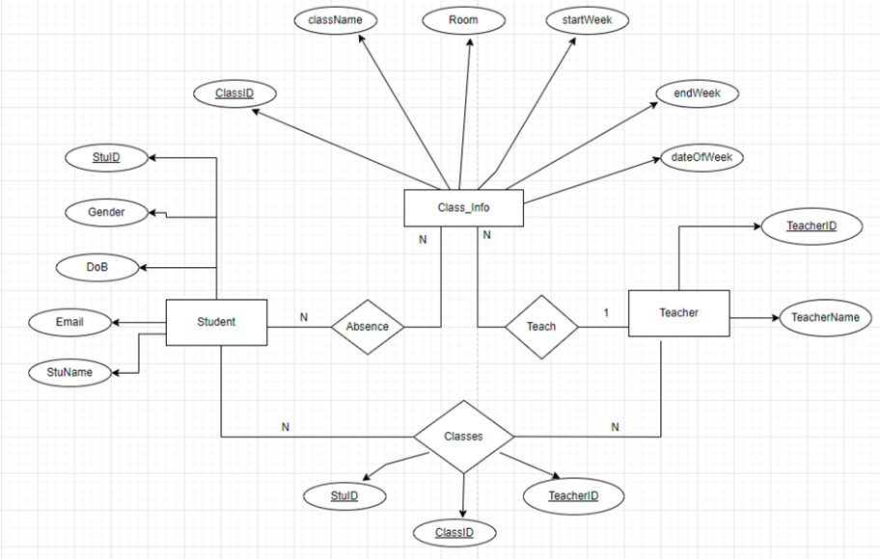
2. ERD AND RELATIONAL SCHEMA
2.2. ER Diagram

Slide 10
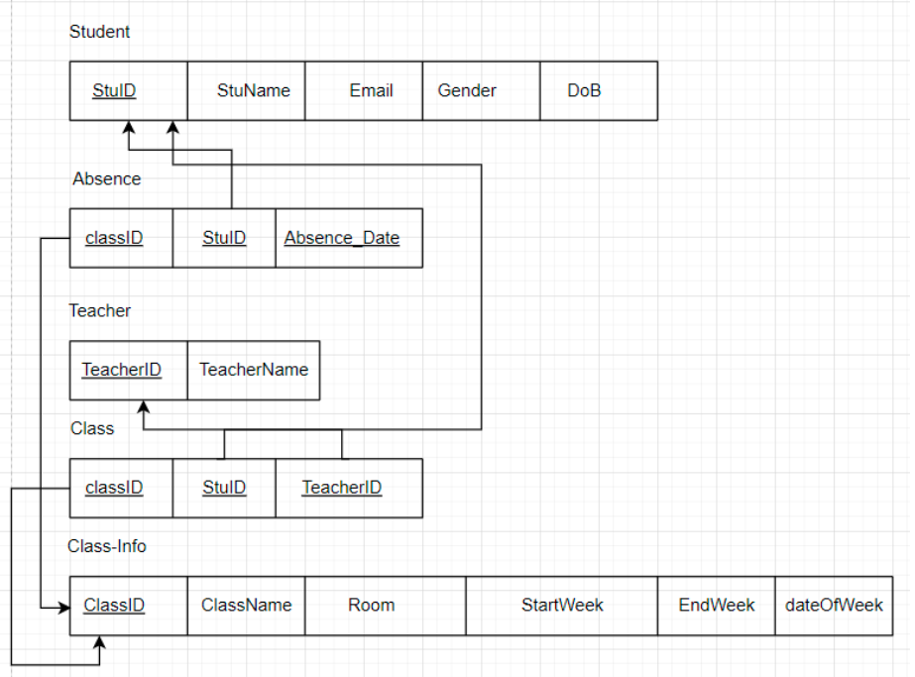
2. ERD AND RELATIONAL SCHEMA
2.3. Relational Model

Slide 11
2. ERD AND RELATIONAL SCHEMA
2.3. Relational Model
The primary keys of each individual entity of this database is as followed:
+ Student - studentID
+ Teacher - TeacherID
+ Class_Info - classID
Absence entity which takes a primary keys of two tables Student and Class_Info and contains the student’s absence date ⇒ The primary key of this entity is (classID, StudentID, absenceDate).
Establish a new ‘Class ’ schema and add as a foreign key all of the primary key attributes of two tables Student and Teacher and add the ClassID ⇒ The primary key of this schema is(classID, StudentID,TeacherID).
Establish a new schema (Teacher and Class_Info) containing the primary keys of the entities that formed it and its own attributes.

Slide 12
3. Implementation
3.1. SQL Implementation
The database of the attendance management system has 5 tables:
Student
Teacher
Class_Info
Class
Absence

Slide 13
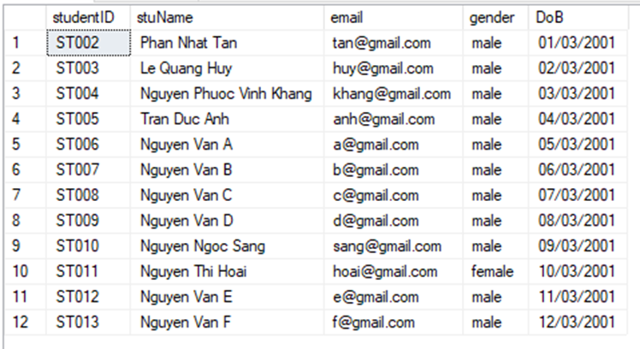
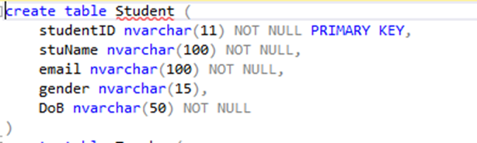
Student table
SQL code of Student Table

Slide 14
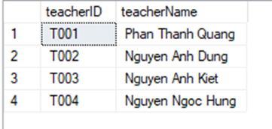
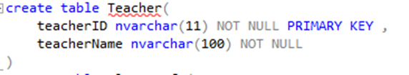
Teacher table
SQL code of Teacher Table

Slide 15
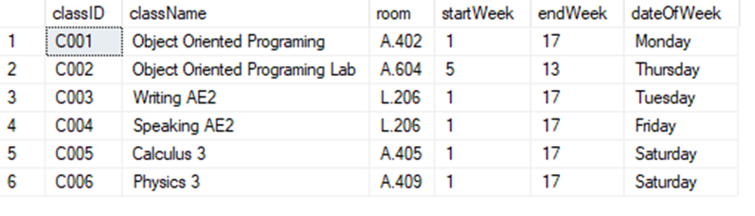
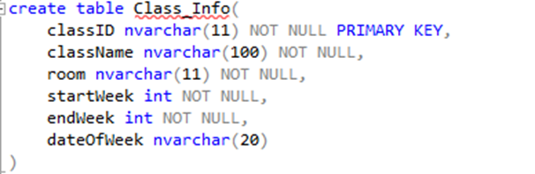
Class_Info
SQL code of Class_Info Table

Slide 16
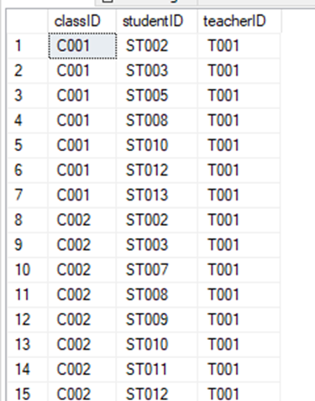
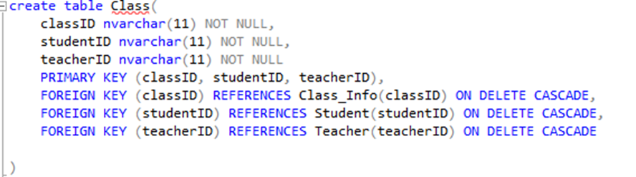
SQL code of Class Table

Slide 17
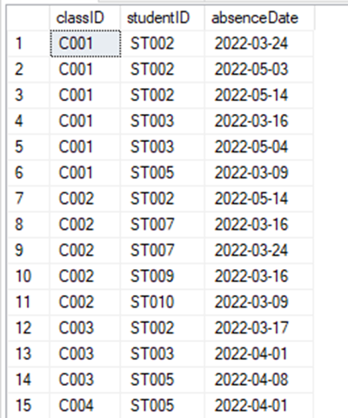
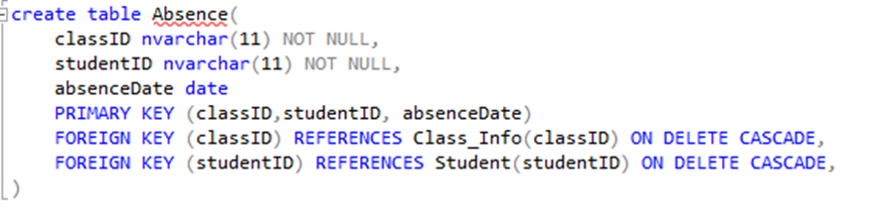
SQL code of Absence Table

Slide 18
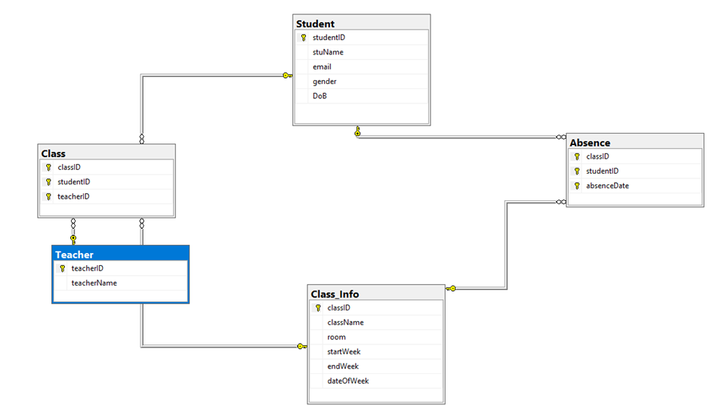
Relational Model for attendance management System in SQL- server

Slide 19
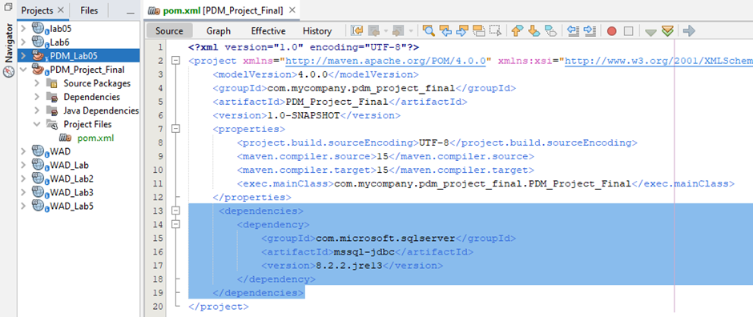
3. Implementation
3.2 Java Implementation
3.2.1. Connect the database to Java:

Slide 20
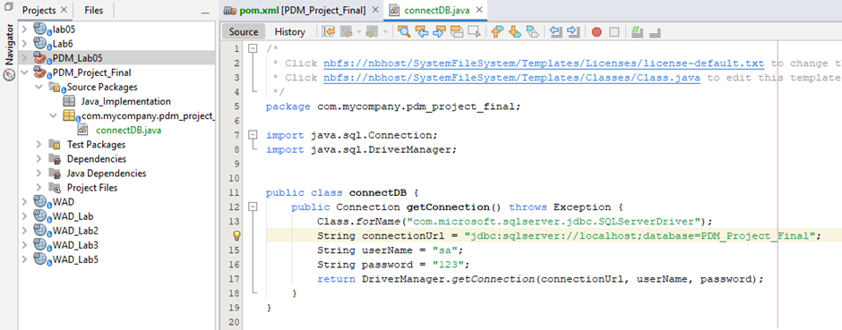
3. Implementation
3.2 Java Implementation
3.2.1. Connect the database to Java

Slide 21
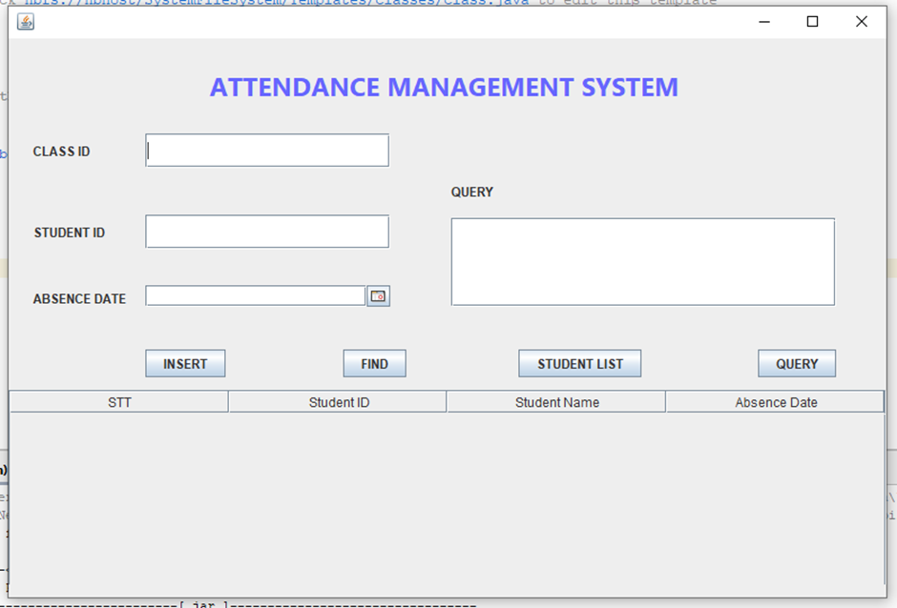
3. Implementation
3.2 Java Implementation
3.2.2. Java for GUI:
We use the drag-drop function of java.swing to create the form of this project. The Netbeans will generate GUI’s code automatically. We just define some functions for buttons and how the data to be loaded in our GUI.
fig 12: User Interface for Querying data.

Slide 22
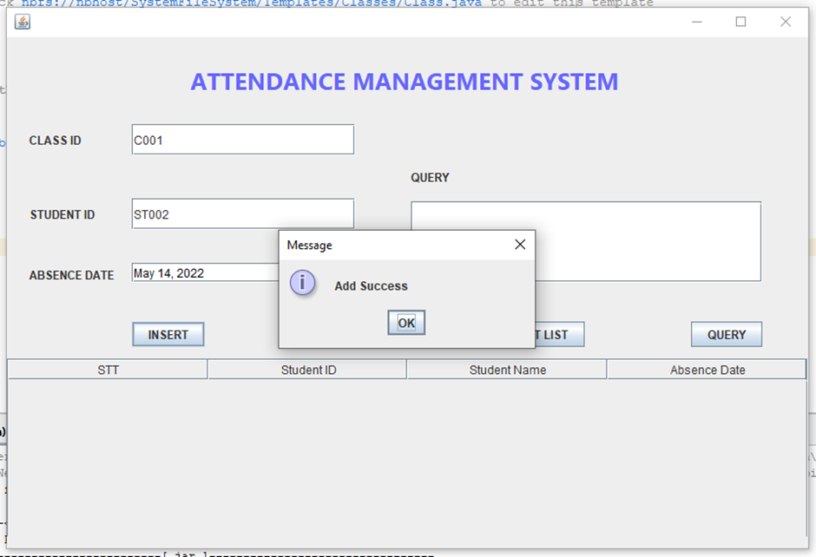
Function
INSERT:
Insert the absence student into the Absence Table. Users will enter the classID, StudentID, Absence date to add a record.
fig 13: Insert Function

Slide 23
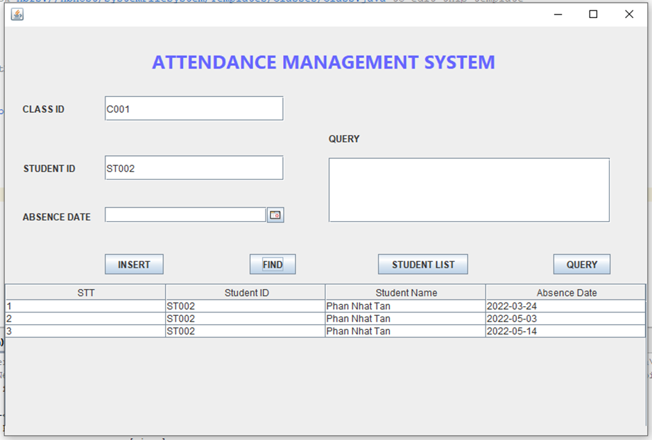
Function
FIND:
To return the absence date of a student. Users will input the classID, studentID.
fig 14: Find Function

Slide 24
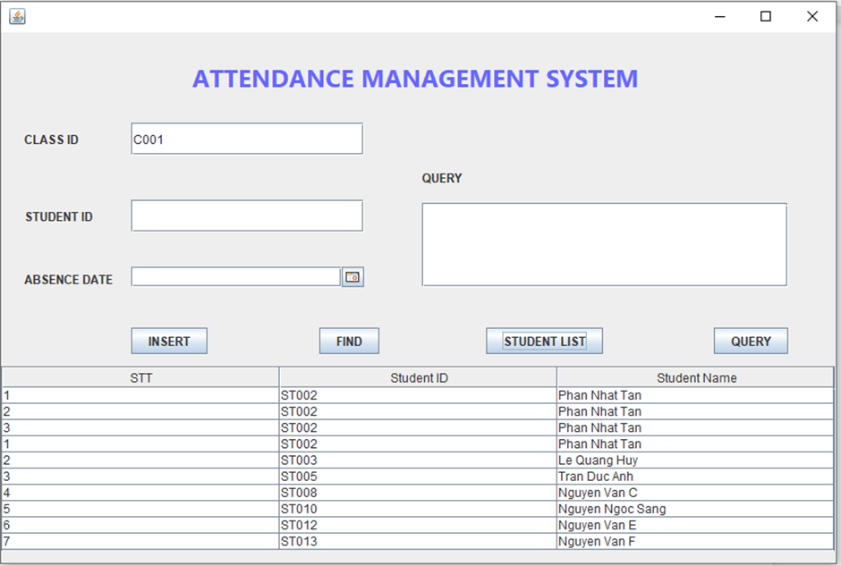
Function
STUDENT LIST:
Use to return the student list of a class.
fig 15: Student List Function

Slide 25
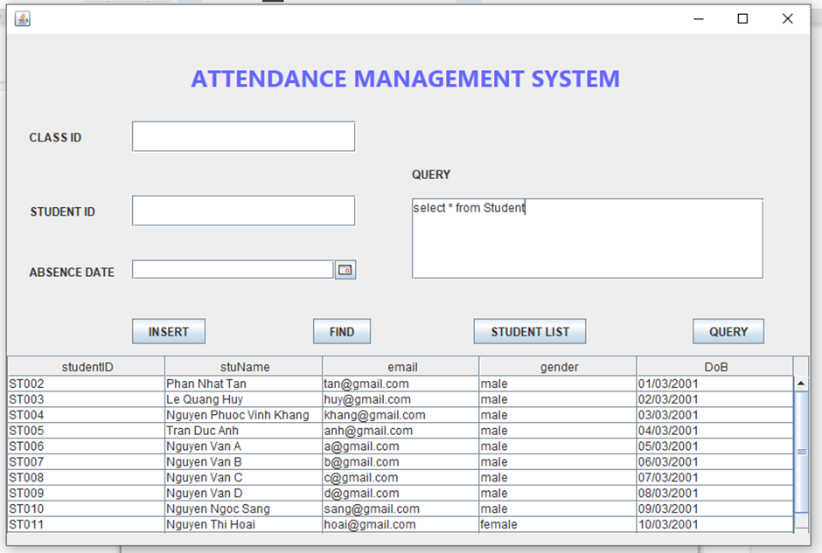
Function
QUERY:
In advance , users can input a SQL sentence to get data from the database.
fig 16: Query Function

Slide 26
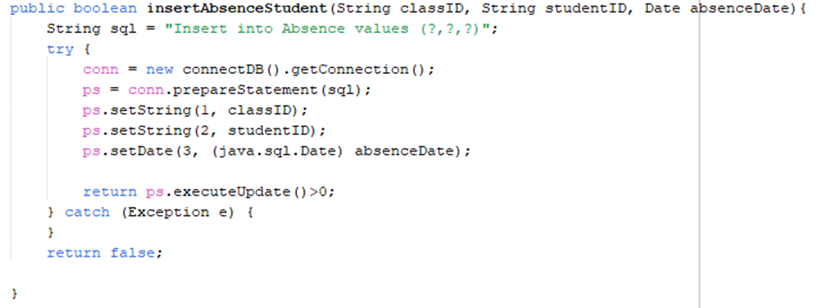
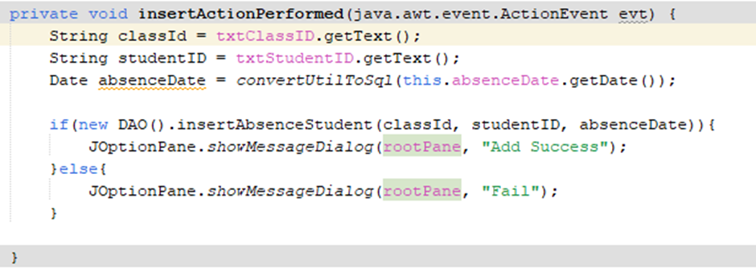
fig 17: Code for Insert function in DAO.java class and View.java class.

Slide 27
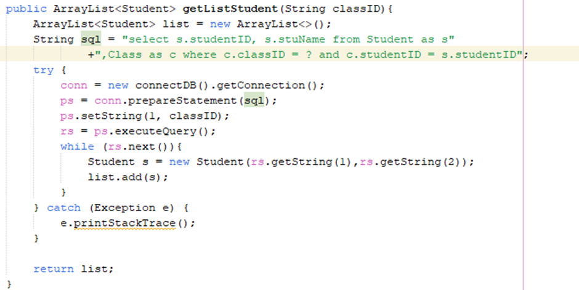
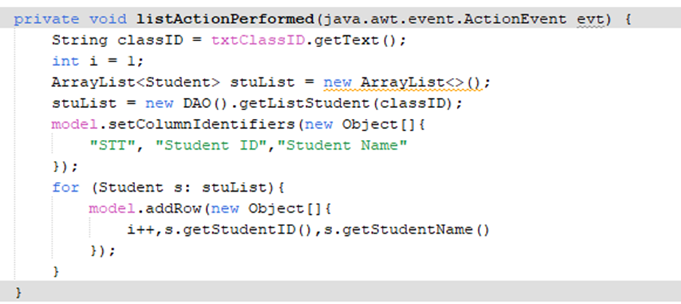
fig 18: Code for ‘Student List’ function in DAO.java class and View.java class

Slide 28
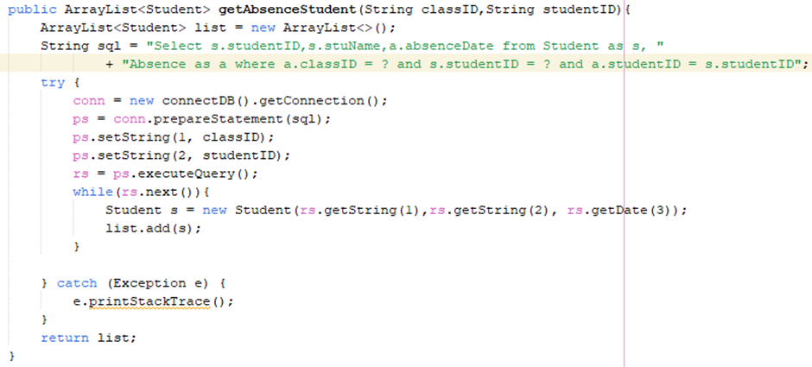
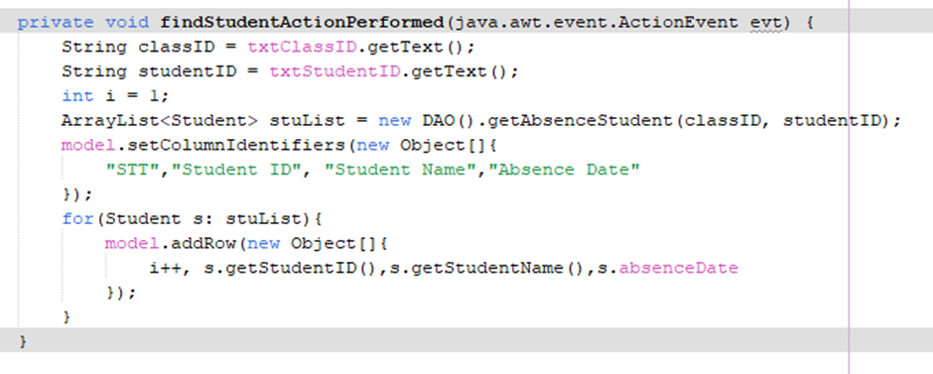
fig 19: Code for ‘Find’ function in DAO.java class and View.java class.

Slide 29
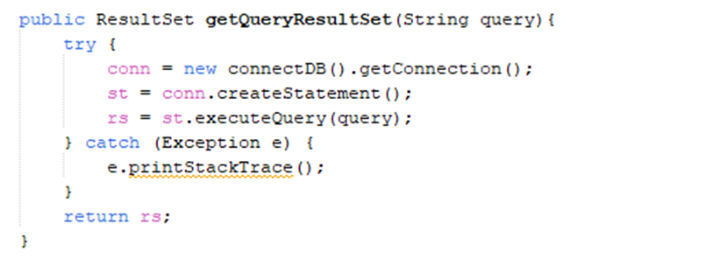
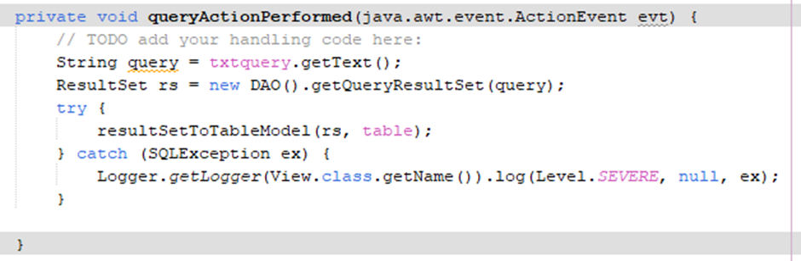
fig 20: Code for ‘Find’ function in DAO.java class and View.java class.

Slide 30
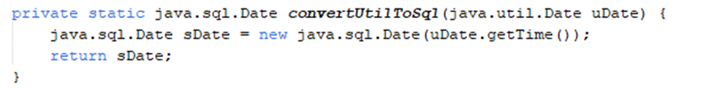
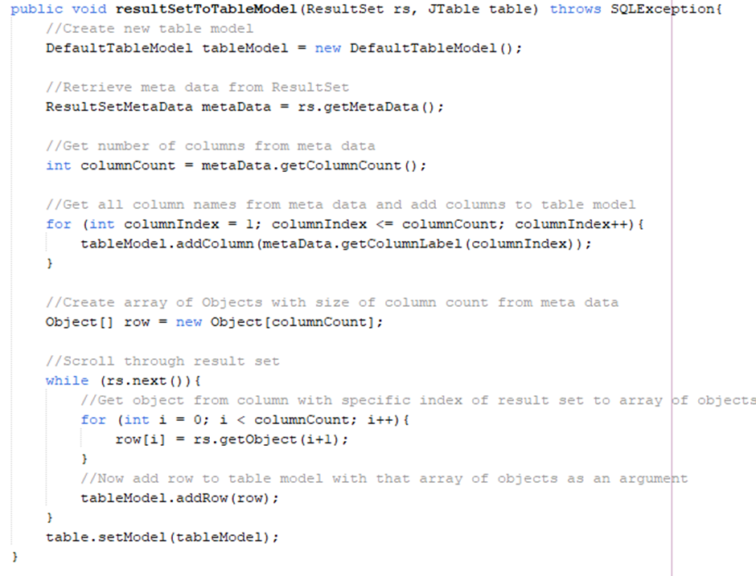
fig 21: Two functions converting util.date to sql.date and populate data from result set to table.

Slide 31
CONCLUSION
In conclusion, our group designed and developed a simple database for attendance management. From this database, we can connect to the java platform and implement some function to populate data from database to GUI. Therefore, we can understand SQL knowledge, converting ERD to Relational Model, normalization of database, or how data to be stored in an application.

Slide 32
REFERENCES
1. What is a database, Oracle, from :
https://www.oracle.com/database/what-is-database/
2. Attendance management, part 2 from:
https://notesformsc.org/attendance-management-part-2/
3. “What is an ER Diagram”, LucidChart, from:
https://www.lucidchart.com/pages/er-diagrams#section_5
4. How to convert ER Diagram to relational Database ,Learn Database, from:
https://www.learndb.com/databases/how-to-convert-er-diagram-to-relational-database
5. Delete cascade and Update Cascade in SQL server foreign key, SQLshack, from:
https://www.sqlshack.com/delete-cascade-and-update-cascade-in-sql-server-foreign-key/

Slide 33
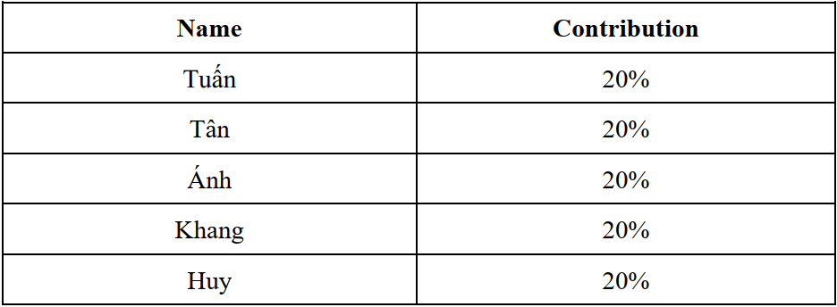
CONTRIBUTION

Slide 34



THANKS !
Do you have any question?
Please keep this slide for attribution

